Slide 1
DAV PROJECT ON SPOTIFY’S MUSIC STREAMING DATA
NAME – SONALI.R
BATCH NO – PGDDM43
PROJECT TITLE – SPOTIFY’S MUSIC STREAMING DATA

Slide 2

Unveiling Insights from Spotify's Music Streaming Data
This presentation delves into the vast trove of data generated by Spotify, exploring user behavior, music trends, and key insights. We will analyze this information to uncover valuable patterns and understand the dynamics of the music streaming landscape.

Slide 3
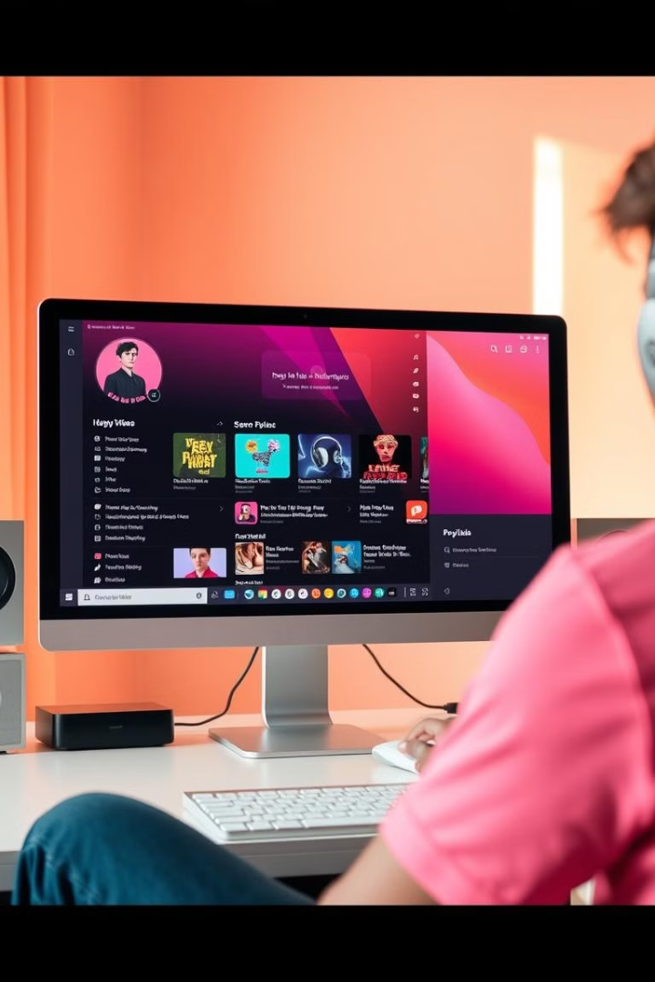
Introduction: Analyzing Spotify's Music Streaming Data
User Behavior
Music Trends
Understanding how users interact with the platform, including listening habits, song preferences, and playlist creation.
Identifying emerging genres, popular artists, and trending songs across different demographics and regions.
Music Consumption Patterns
Analyzing how users consume music, including factors like listening duration, frequency, and time of day.

Slide 4
Data Collection and Preprocessing
Data Sources
Data Cleaning and Transformation
Spotify gathers data from various sources, including user interactions, music metadata, and external APIs.
Collected data is cleaned and preprocessed to ensure consistency and remove noise. This involves tasks like handling missing values, standardizing data formats, and transforming features.
User activity data includes listening history, song skips, playlists, and social interactions.
For example, audio features like tempo, key, and loudness are normalized to a standard scale.
Music metadata encompasses information about artists, albums, genres, and song features.

Slide 5
Exploratory Data Analysis
Descriptive Statistics
Data Visualization
Correlation Analysis
Basic statistics like mean, median, and standard deviation provide initial insights into key variables.
Visualizing data through graphs, charts, and heatmaps reveals patterns and relationships.
Measuring the strength and direction of relationships between variables to identify key dependencies.
These metrics help to understand the central tendency and spread of data.
Histograms, scatter plots, and box plots offer different perspectives for data exploration.
Correlation coefficients reveal how closely variables change together.

Slide 6



Popular Music Genres and Trends
Pop
Rock
Electronic Music
Pop music remains a dominant force, attracting a broad audience with its catchy melodies and upbeat rhythms.
Rock music continues to evolve, with subgenres like indie rock and alternative rock gaining popularity.
Electronic music genres, including EDM, house, and techno, have grown rapidly, driven by festivals and online platforms.

Slide 7
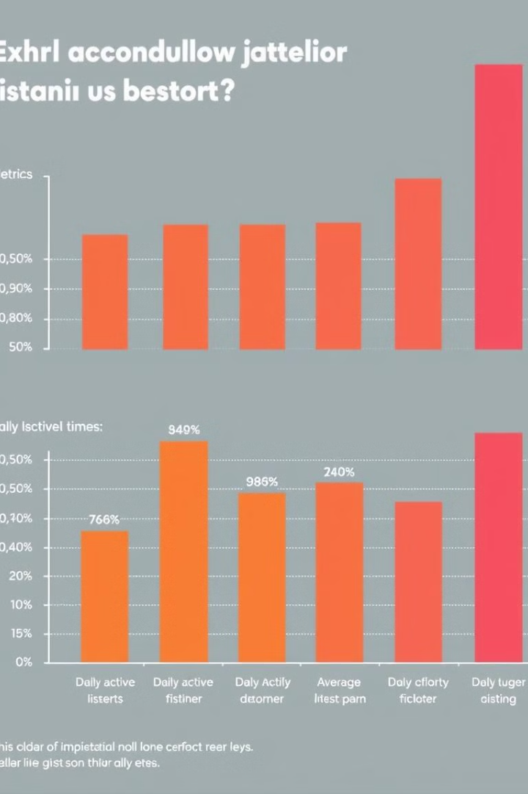
User Engagement Metrics
200M
Daily Active Users
Millions of users engage with Spotify daily, highlighting its vast and active user base.
2.5H
Average Listening Time
Users spend hours listening to music, indicating strong engagement and user satisfaction.
50B
Song Plays
Billions of songs are played on Spotify, illustrating the platform's massive reach and impact on music consumption.

Slide 8




Predicting Song Popularity
1
Overall Popularity
Audio Features
2
Tempo, key, loudness, and other musical characteristics influence listener engagement.
User Behavior
3
Listen counts, skips, playlist additions, and social interactions provide valuable signals.
External Factors
4
Media coverage, artist collaborations, and cultural trends contribute to a song's success.

Slide 9





Identifying Emerging Artists
Play Count Analysis
User Saves and Playlist Additions
Tracks with increasing play counts and consistent growth are indicative of rising popularity.
Songs saved or added to playlists suggest a genuine interest and deeper engagement by users.
Social Media Engagement
Audio Feature Analysis
Increased shares, mentions, and follows on social media platforms signal growing fan bases.
Analyzing audio features like tempo, key, and loudness helps identify unique sonic signatures of potential breakout artists.

Slide 10
Recommendations for Spotify's Marketing Strategies
Personalized Recommendations
1
Leverage user data to personalize music recommendations.
Targeted Advertising
2
Use demographic and behavioral data to target ads effectively.
Artist Promotion
3
Highlight emerging artists through curated playlists and promotions.
Exclusive Content and Experiences
4
Offer exclusive content and experiences to engage users.

Slide 11
Limitations and Future Directions
Data Privacy and Security
Bias and Fairness
Real-Time Data Processing
Evolving Music Landscape
Algorithms used for recommendations or analysis could exhibit bias, potentially leading to unfair outcomes. Mitigation strategies are crucial.
Protecting user data and ensuring privacy is paramount. Maintaining data security and preventing unauthorized access is essential.
Scaling data processing capabilities to handle real-time streams and maintain low latency is a continuous challenge.
The music industry is dynamic, with emerging trends and technologies. Adapting algorithms and analysis methods is vital.

Slide 12
CONCULSION: * Spotify regularly releases data insights and conclusions based on user behavior, music streaming trends, and platform analytics. Here are a few key types of data conclusions that Spotify has drawn over the years: * Spotify's data shows that personalized playlists like Discover Weekly are effective in helping users discover new music, increasing engagement with the platform. * Spotify’s data-driven conclusions help the company continuously innovate and create personalized experiences for users, while also guiding artists, record labels, and advertisers in understanding how people consume music and other audio content.

